Slide 1
Information Science
GSCI1801A
Lecture 4: Artificial Intelligence and Applications in Daily Life
Asst. Prof. Chawanat Nakasan | 2020-10-26

Slide 2
Agenda
What is Artificial Intelligence?
Optimization Problems
Genetic Algorithm
Machine Learning Concepts
Linear Regression
Neural Networks
Deep Learning

Slide 3
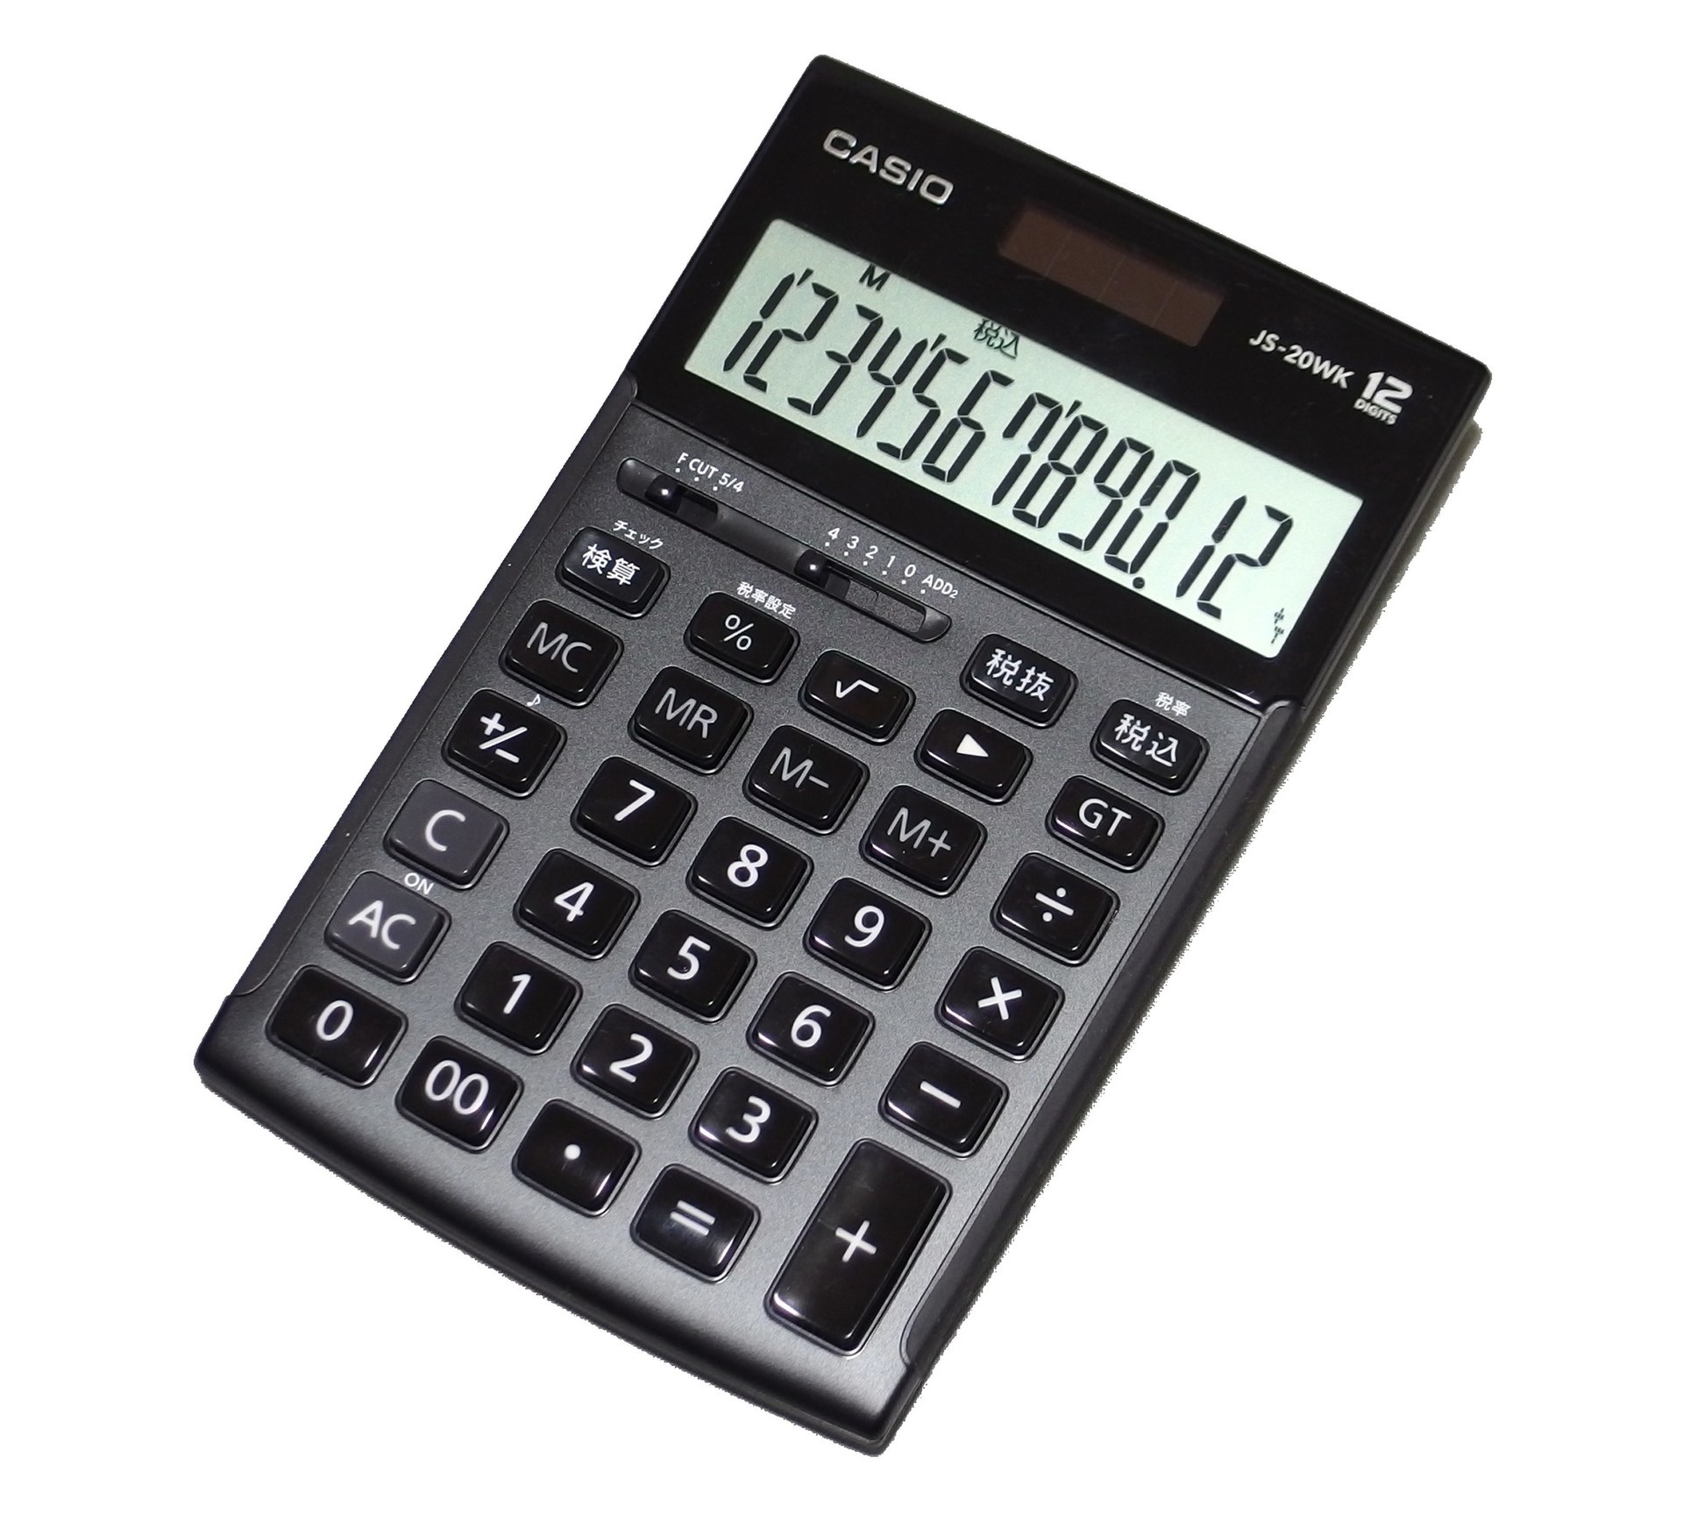
What is Artificial Intelligence?
Up until now, all we have is a glorified calculator.
It has more functions, it’s faster, but still a calculator.
How do we make computers actually think and help us decide?
Graphics: Mc681/Wikipedia

Slide 4
Context of AI and Algorithms
Artificial Intelligence
Algorithms in General
Some algorithms are not used to build an AI system.
All AI systems require some sort of algorithm.

Slide 5
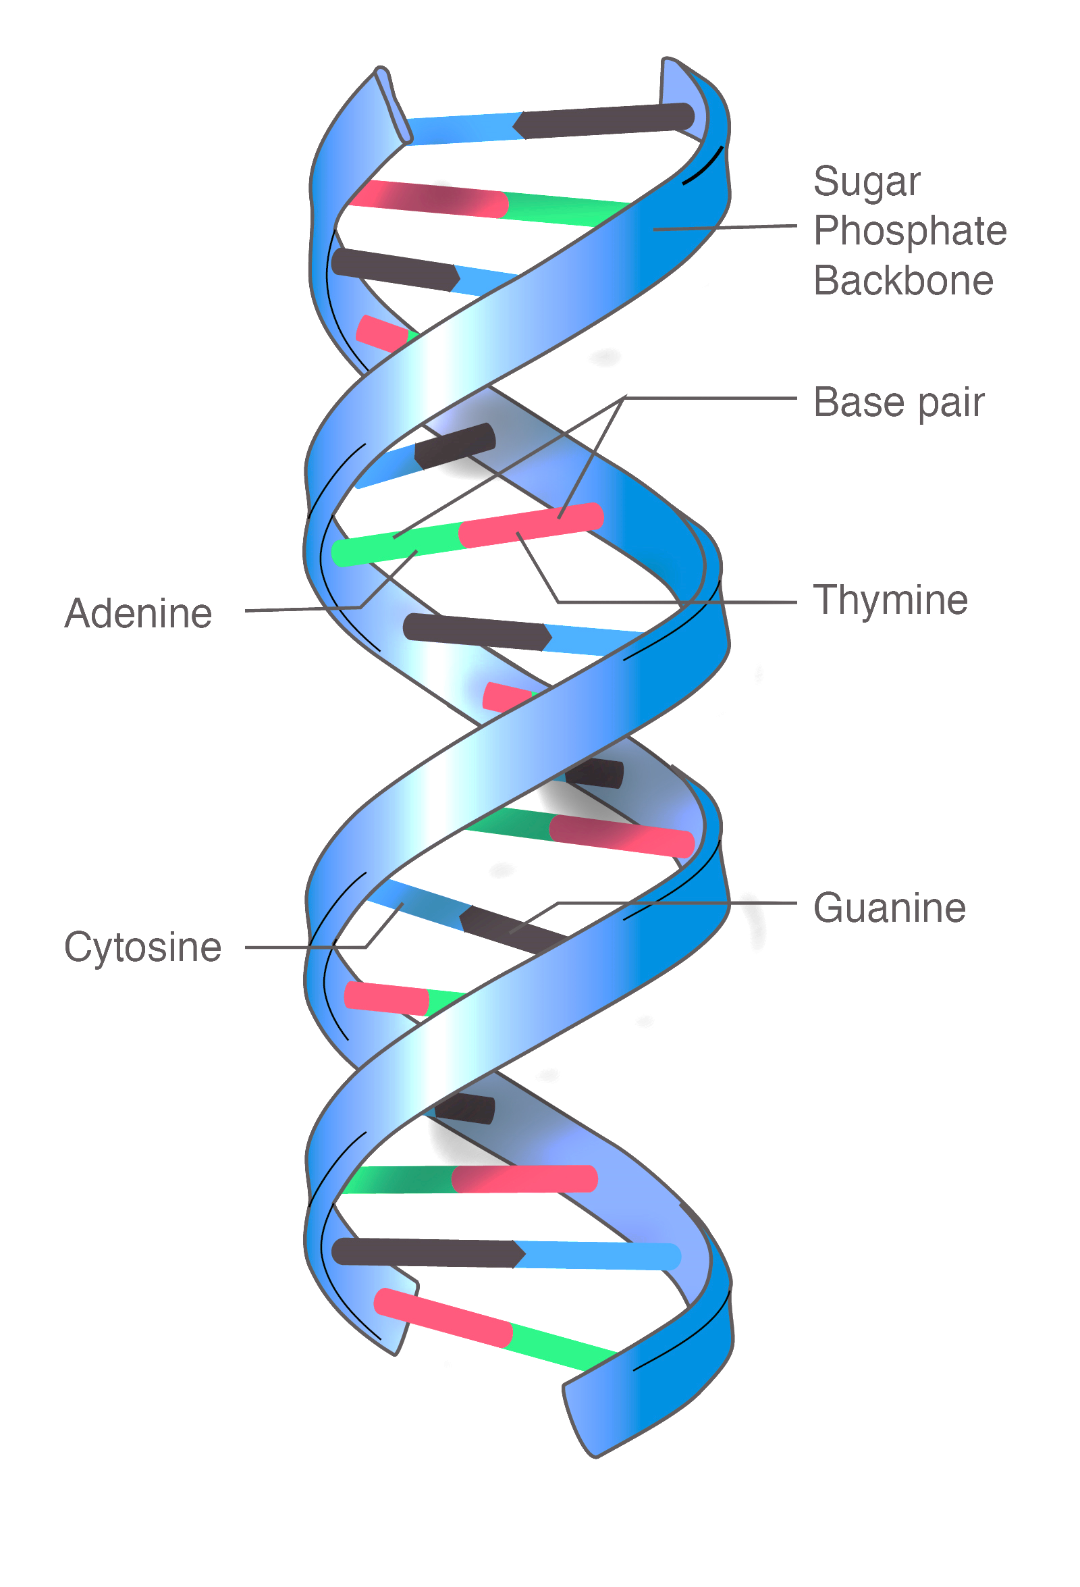
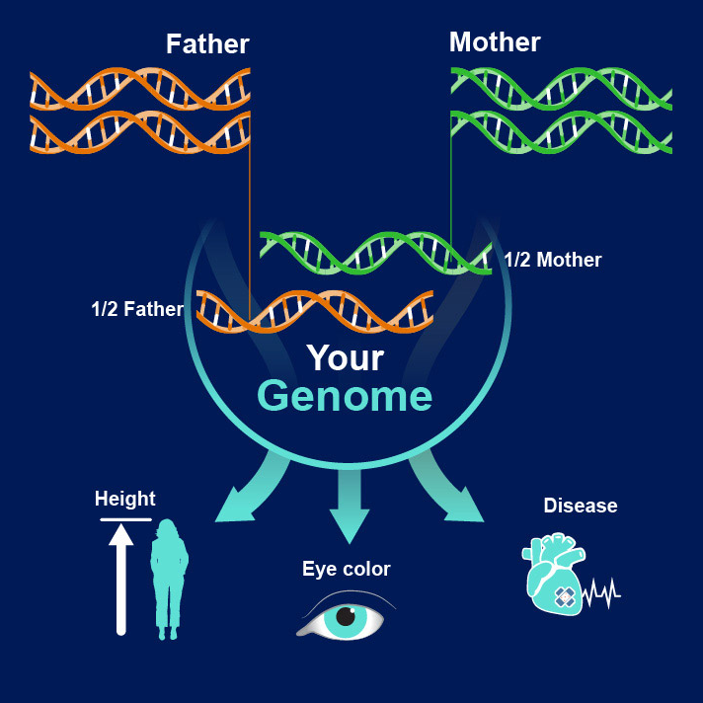
Genetic Algorithm (GA)
Inspired by nature, GA involves using genetic methods and evolution to create a solution to a problem.
Graphics: National Human Genome Research Institute [Left/BG] [Right]

Slide 6
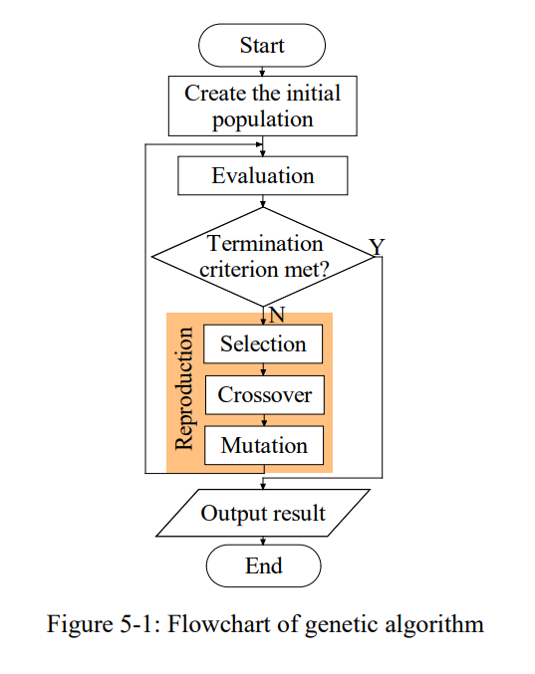
Genetic Algorithm (GA)
Initial Population: Random set of possible solutions (“candidates”).
Selection: Pick the best candidates.
Crossover: Use genetic concepts to “breed” pairs of selected candidates.
Mutation: Mutate the new candidates to introduce random-walking variation.
(Weng, 2021)

Slide 7
Back to the ’sack: Not everything is solved by greed! (And not everything is solved quickly enough by brute force)
Weight | Value | V/W
15 | 12 | 0.800
90 | 15 | 0.167
*20 | 120 | 6.000
*120 | 720 | 6.000
25 | 30 | 1.200
*40 | 240 | 6.000
*20 | 120 | 6.000
50 | 20 | 0.400
30 | 20 | 0.667
20 | 18 | 0.900
35 | 55 | 1.571
#191 | 1147 | 6.005
* Brute-forced solution: $1200, 120 kg
O(2^{n}). 12 objects isn’t too tough for brute-forcing, but it won’t work in the real world.
# Greedy solution: $1147, 191 kg
O(n log n). However, blindingly choosing highest V/W produces suboptimal results.
Max weight = 200

Slide 8
GA: Selection
Weight | Value | V/W
15 | 12 | 0.800
90 | 15 | 0.167
20 | 120 | 6.000
120 | 720 | 6.000
25 | 30 | 1.200
40 | 240 | 6.000
20 | 120 | 6.000
50 | 20 | 0.400
30 | 20 | 0.667
20 | 18 | 0.900
35 | 55 | 1.571
191 | 1147 | 6.005
1
1
1
1
1
1
1
$275, 195 kg
Initial Generation
1
1
1
1
1
1
$585, 170 kg
1
1
1
1
1
$287, 195 kg
1
$1147, 191 kg
1
1
1
1
1
1
1
$275, 195 kg
1
1
1
1
1
1
$585, 170 kg
Selection
1
1
1
1
1
$287, 195 kg
1
$1147, 191 kg
Max weight = 200

Slide 9
GA: Crossover
Parent 1
1
1
1
1
1
1
Parent 2
1
Crossing point
Crossing points
1
1
1
1
1
1
1
1
1
1
1
1
1
1
Single-point crossover
Two-point crossover
1
1
1
1
1
1
1
1
1
1
1
1
1
1
Multi-point crossover (“odd-even”)
Multi-point crossover (“random”)
There are many kinds of crossovers invented, reviewed and described in many papers (Poon & Carter, 1995; Kaya, 2011)

Slide 10
GA: Mutation
Child 1
Child 2
1
1
1
1
1
1
1
0
1
1
1
1
1
1
1
Mutation can be done by changing random bit(s) or other methods.

Slide 11
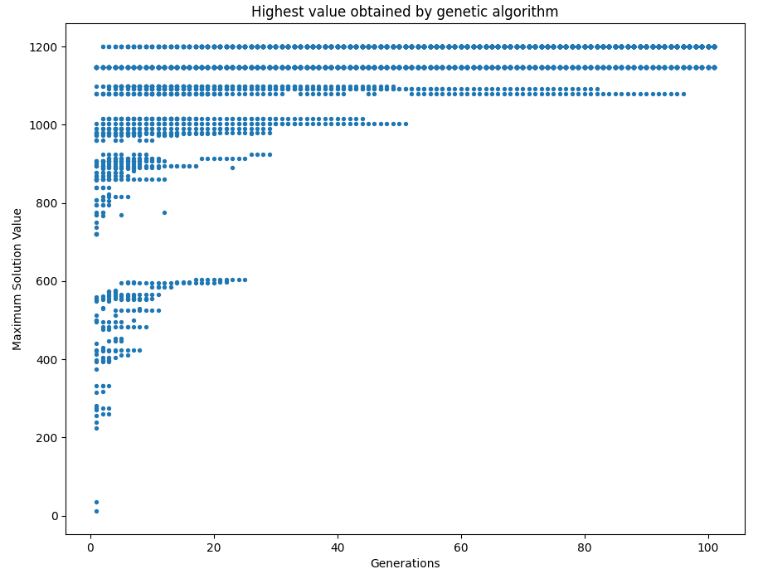
Results of GA: A system that improves itself
I wrote this in Python and charted its performance.
Each dot represents one (or more) repeated executions of the GA program.
You can see that there is an upward trend of the dots the more generations we run.

Slide 12
Machine Learning

Slide 13
How can computers learn?
I still maintain the idea that computers understand only 0 and 1.

Slide 14
Supervised & Unsupervised Learning
Supervised Learning
Unsupervised Learning
Teaching with pre-trained data or samples.
Examples:
Regression
Biometric Recognition
Find new relationships without pre-trained data.
Examples:
Clustering
Outlier Detection

Slide 15
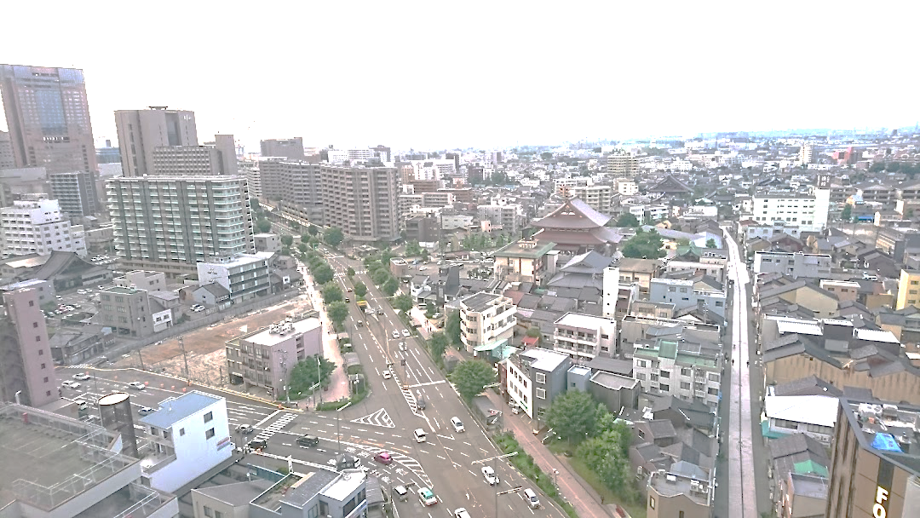
Regression: What influences housing prices?
2LDK
90,000¥/mo
1DK
40,000¥/mo
1K
30,000¥/mo
3LDK
140,000¥/mo
2LDK
80,000¥/mo
2DK
65,000¥/mo
Photograph: Own work, taken from ANA Holiday Inn Kanazawa Sky

Slide 16
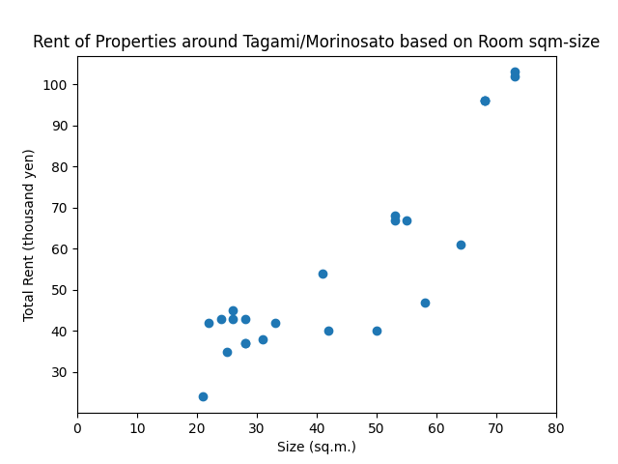
Converting Data Points to Insights: Establishing a Trend

Slide 17
There is a trend here, but how do we explain the relationship?
y = mx + c
m = ? ➔ θ₁
c = ? ➔ θ₀
We choose to draw straight lines (linear relationship), so we call this Linear Regression.

Slide 18
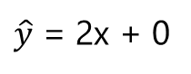
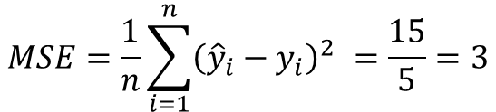
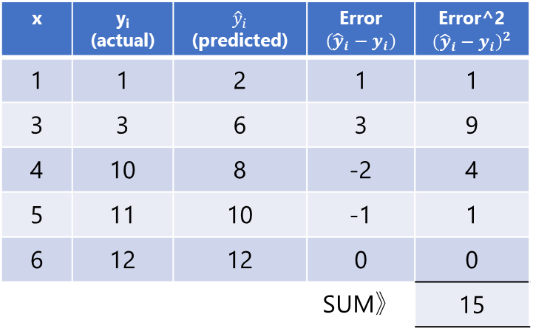
Cost Function
Cost function is a key component to linear regression.
It shows how good our choice of m and c is.
$\hat{y}$ = 2x + 0
x | y_{i} (actual) | ${\hat{y}}_{i}$ (predicted) | Error $$\left({\hat{y}}_{i}−y_{i}\right)$$ | Error^2 $${\left({\hat{y}}_{i}−y_{i}\right)}^{2}$$
1 | 1 | 2 | 1 | 1
3 | 3 | 6 | 3 | 9
4 | 10 | 8 | -2 | 4
5 | 11 | 10 | -1 | 1
6 | 12 | 12 | 0 | 0
 |  |  | SUM》 | 15
This is error.
$$MSE=\frac{1}{n}\sum_{i=1}^{n}{{\left({\hat{y}}_{i}−y_{i}\right)}^{2} }=\frac{15}{5}=3$$
(This is a separate example not related to the housing data.)

Slide 19
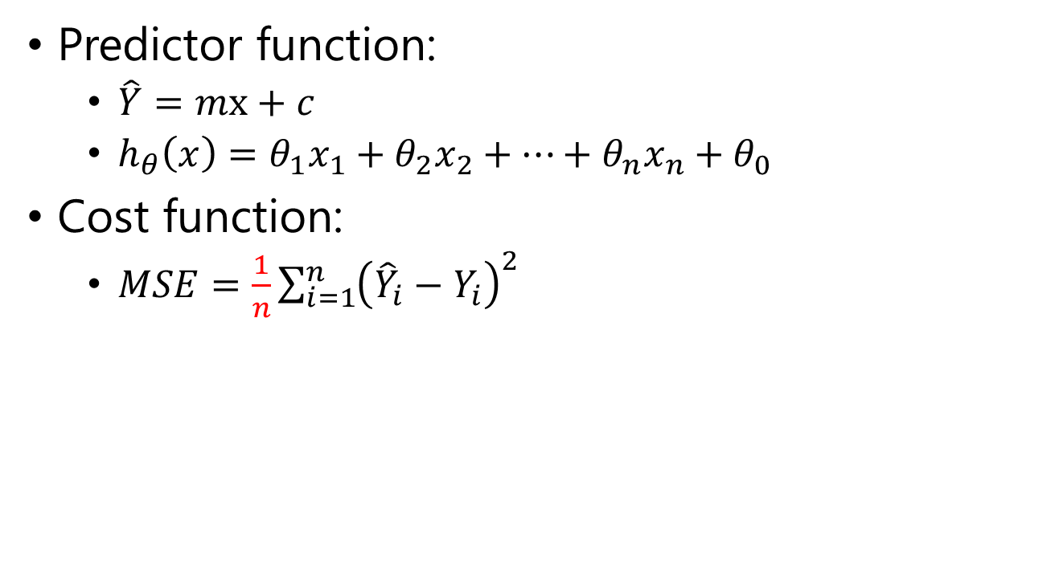
That’s all the characters introduced.
Predictor function:
$\hat{Y}=mx+c$
$h_{θ}\left(x\right)=θ_{1}x_{1}+θ_{2}x_{2}+…+θ_{n}x_{n}+θ_{0}$
Cost function:
$MSE=\frac{1}{n}\sum_{i=1}^{n}{{\left({\hat{Y}}_{i}−Y_{i}\right)}^{2} }$

Slide 20
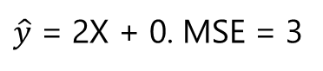
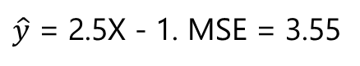
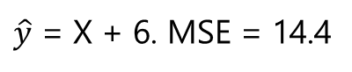
How to adjust m and c?
$\hat{y}$ = 2X + 0. MSE = 3
$\hat{y}$ = 2.5X - 1. MSE = 3.55
$\hat{y}$ = X + 6. MSE = 14.4

Slide 21
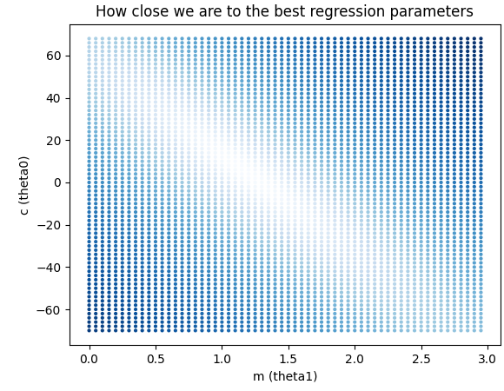
Gradient Descent Concept (No, we’re not going to brute force again.)
※ apartments dataset
Suppose we’re here
And we know this is where the best parameters are.
We should move as indicated by the purple arrow, i.e. “downwards”.

Slide 22
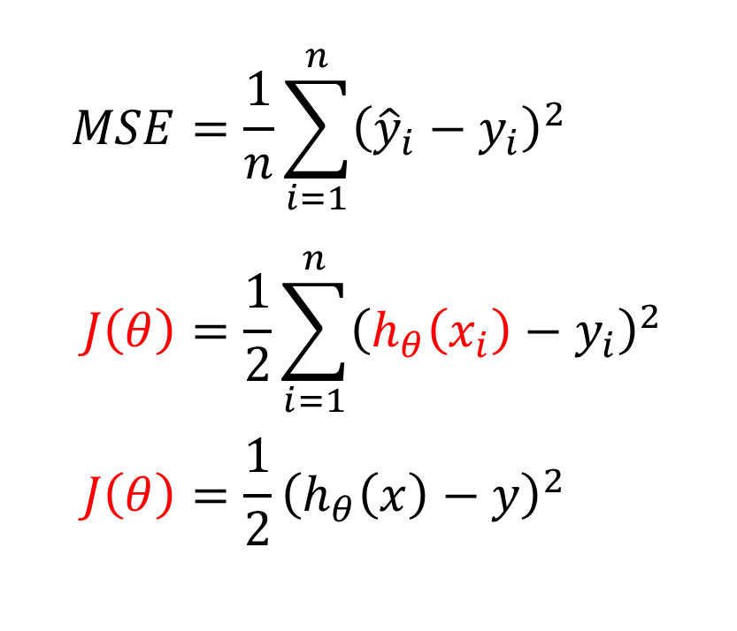
Gradient Descent Magic Math (This is the hardest math today.)
$$MSE=\frac{1}{n}\sum_{i=1}^{n}{{\left({{\hat{y}}_{i}−y}_{i}\right)}^{2} } \\ J\left(θ\right)=\frac{1}{2}\sum_{i=1}^{n}{{\left(h_{θ}\left(x_{i}\right)−y_{i}\right)}^{2} } \\ J\left(θ\right)=\frac{1}{2}{\left(h_{θ}\left(x\right)−y\right)}^{2}$$
For the purpose of this class, we’ll formally define the cost function as ➔
In case of only one data point:

Slide 23
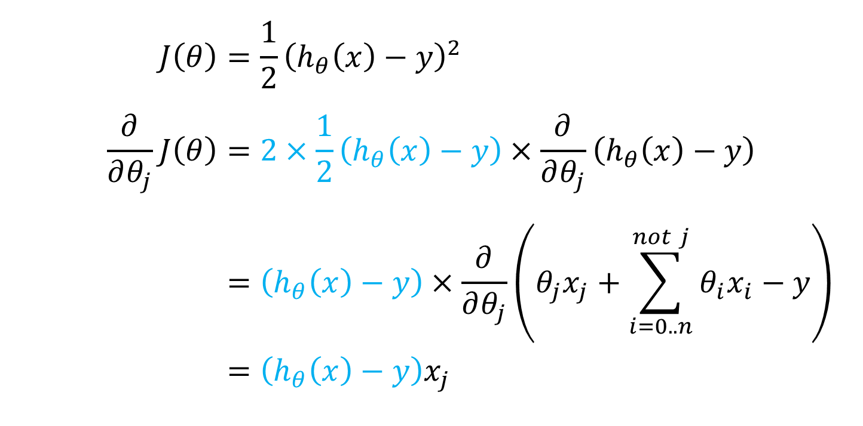
Gradient Descent Math (Continued)
Derivative of the inside
$$J\left(θ\right)={\frac{1}{2}\left(h_{θ}\left(x\right)−y\right)}^{2} \\ \frac{∂}{∂θ_{j}}J\left(θ\right)=2×\frac{1}{2}\left(h_{θ}\left(x\right)−y\right)×\frac{∂}{∂θ_{j}}\left(h_{θ}\left(x\right)−y\right) \\ =\left(h_{θ}\left(x\right)−y\right)×\frac{∂}{∂θ_{j}}\left(θ_{j}x_{j}+\sum_{i=0..n}^{not j}{θ_{i}x_{i}}−y\right) \\ =\left(h_{θ}\left(x\right)−y\right)x_{j}$$
Continue derivation
Chain Rule:
0
0

Slide 24
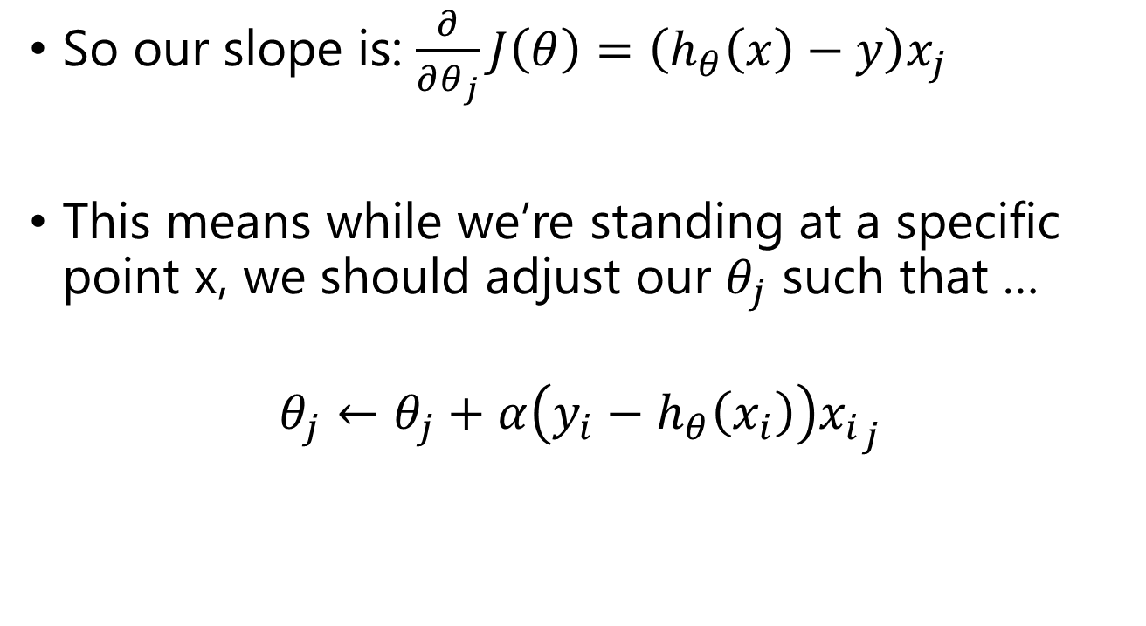
Gradient Descent Math (Final math slide, I promise)
So our slope is: $\frac{∂}{∂θ_{j}}J\left(θ\right)=\left(h_{θ}\left(x\right)−y\right)x_{j}$
This means while we’re standing at a specific point x, we should adjust our $θ_{j}$ such that …
$$θ_{j}←θ_{j}+α\left(y_{i}−h_{θ}\left(x_{i}\right)\right){x_{i}}_{j}$$

Slide 25
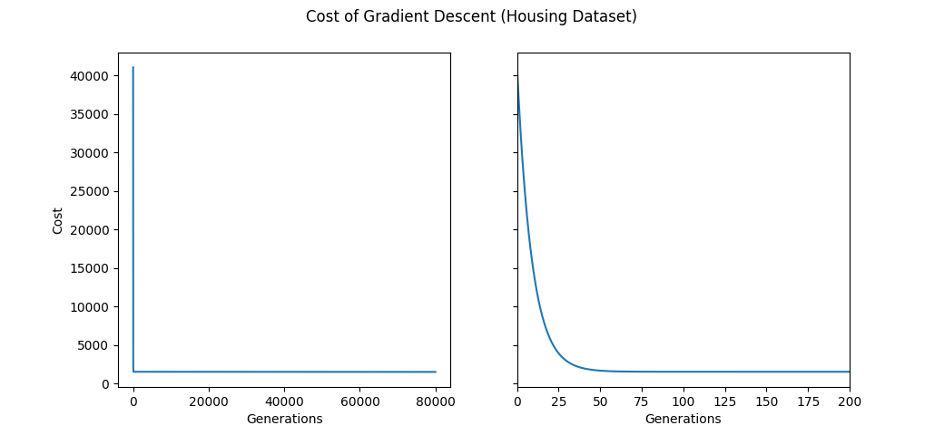
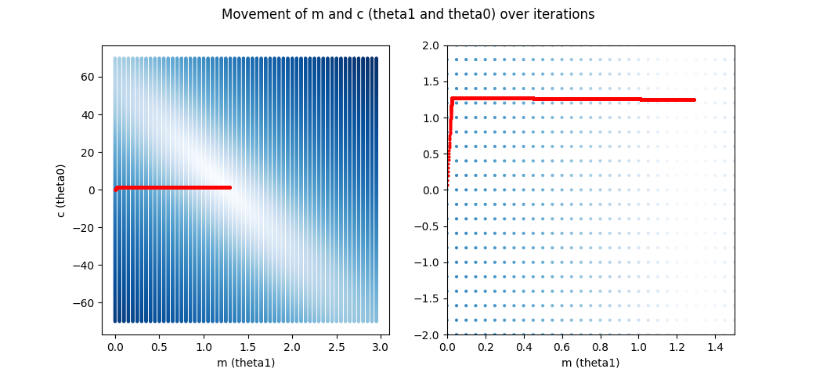

Slide 26
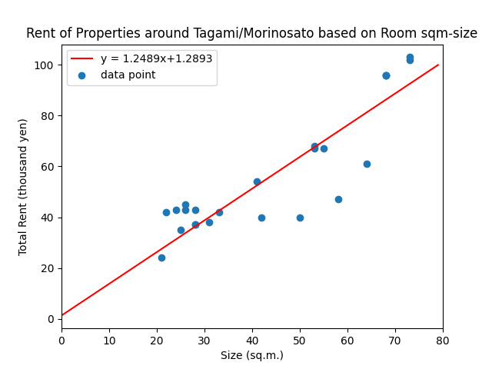
Finally!

Slide 27
Other forms of regression exist!
Logistic regression
Answer yes/no using value inputs
Polynomial regression
Predict more complex systems
Others exist, but linear + logistic + polynomial is usually good enough for general production use.

Slide 28
Uses of Regression
Explain factors behind phenomena
Why housing is expensive?
What makes this animal big?
What contributes to the success of this product?
Predict future values
Note: Predicting “out of range” isn’t a very good idea.

Slide 29
But in real life, we can do more.
Size (m²)
Type of Internet
Rooms+LDK
City or LP Gas
Building Age
Security
They all affect
Price!
Floor of Room
Distance from Work/School
Multivariate regression is also possible, but it’s just additional complexity so let’s just go for now.
Transportation
Qualitative Factors

Slide 30
Neural Network

Slide 31
What is Neural Network (NN)?
Simulation and approximation of neural systems.
Since we’re making an artificial one, sometimes we say, “artificial neural network” (ANN) to be specific.
Input Layer
Hidden Layer(s)
Output Layer

Slide 32
What makes NNs work?
Each neuron activates (fires) based on inputs leading to it.
This is based on magic math.
Input Layer
Hidden Layer(s)
Output Layer

Slide 33
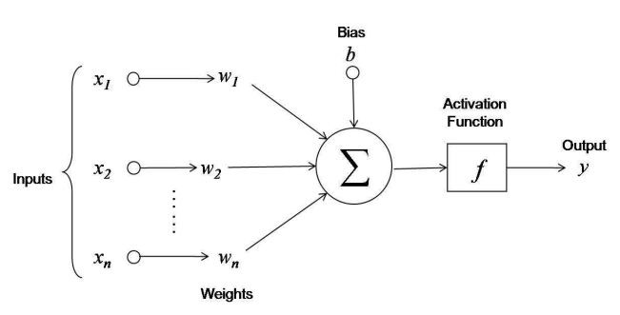
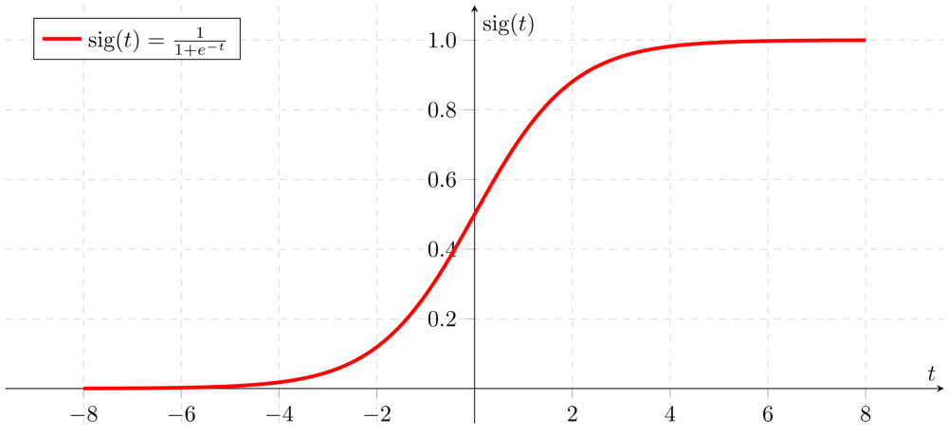
Specifically, this kind of math.
Graphics: https://towardsdatascience.com/first-neural-network-for-beginners-explained-with-code-4cfd37e06eaf

Slide 34
Simulation & Playground
https://playground.tensorflow.org/

Slide 35
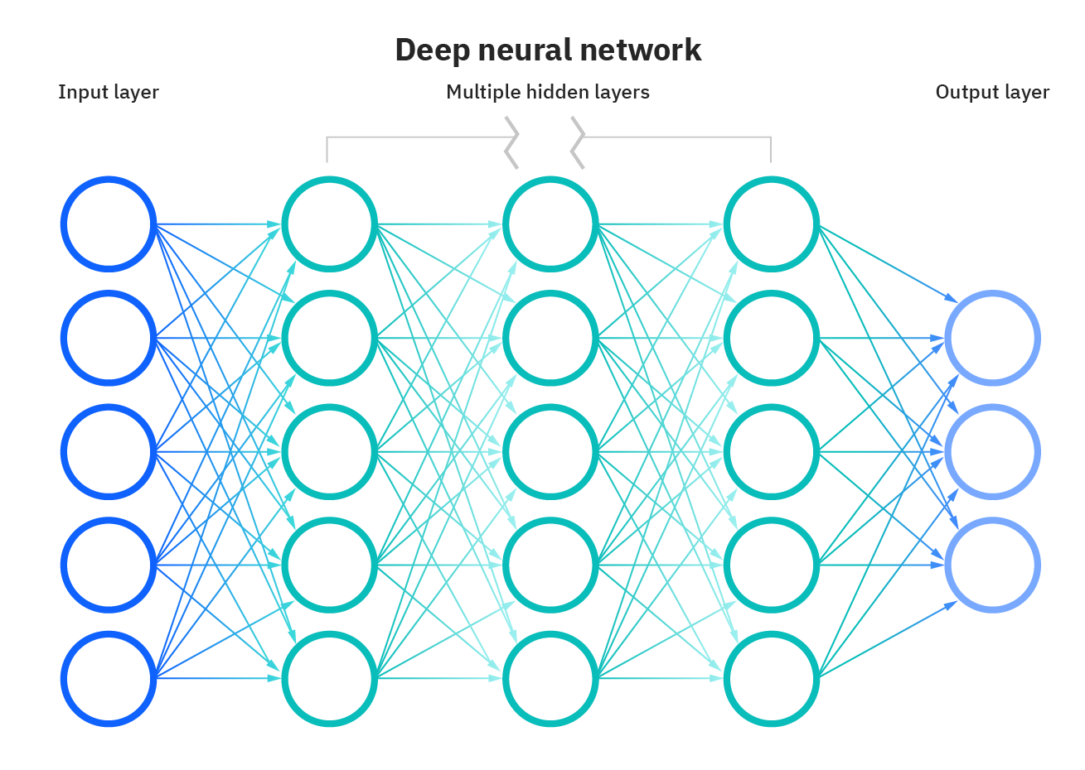
Wait, what about deep learning?
Graphics: https://www.ibm.com/cloud/learn/neural-networks

Slide 36
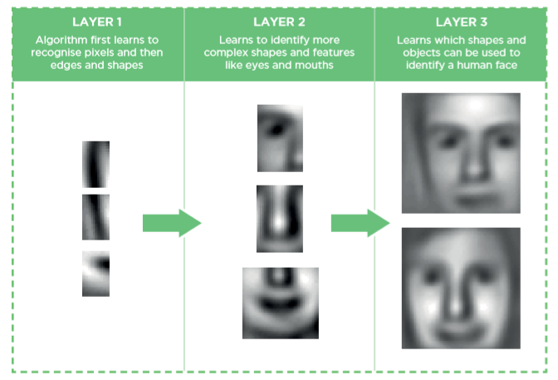
Why add more layers?
Graphics: https://towardsdatascience.com/why-deep-learning-is-needed-over-traditional-machine-learning-1b6a99177063

Slide 37
References
Part of the content on this lecture (linear regression) is based on Prof. Andrew Ng’s lecture notes.
https://see.stanford.edu/materials/aimlcs229/cs229-notes1.pdf

